Slide 1
Technical Communication
&
Its Features

Slide 2
Meaning of Communication
The origin of the English word “communication” is Latin word “communicare” or “communis” which means “to impart”, “to participate”, “to share” or “to make common.” The sense of sharing is inherent in the very origin and meaning of “communication.”

Slide 3
Definition of Communication
Communication is simply the act of transferring information from one place, person or group to another.
1.Keith Davis: Communication is a process of passing information and understanding from one person to another.
2. John Adair: Communication is essentially the ability of one person to make contact with another and make himself or herself understood.

Slide 4
Technical communication
Technical communication is a means to convey scientific, engineering, or other technical information.
Technical Communication focuses on technical or specialized topics, communicates specifically by using technology or provides instructions on how to do something.

Slide 5
PURPOSE OF COMMUNICATION
Technical communication serves three basic purposes:
To inform: Anticipate and answer your readers’ questions
To instruct: Enable your readers to perform certain tasks
To persuade: Motivate your readers

Slide 6
Process of Communication
It majorly consists of five blocks/processes:
Ideation
Encoding
Transmission
Decoding
Feedback

Slide 7
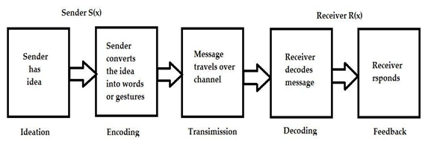
Cont….

Slide 8
Difference between general and Technical communication
General Communication
Technical Communication
Contains a general message.
Informal in style and approach .
Indefinite pattern.
Mostly oral mode of propagation .
Not always for a specific audience. .
Less use of technical terms or graphics .
Contains a technical message .
Mostly formal in style and approach.
Follows a set pattern .
Both oral and written way .
Always for a specific audience .
Frequently involves jargons, graphics etc.

Slide 9
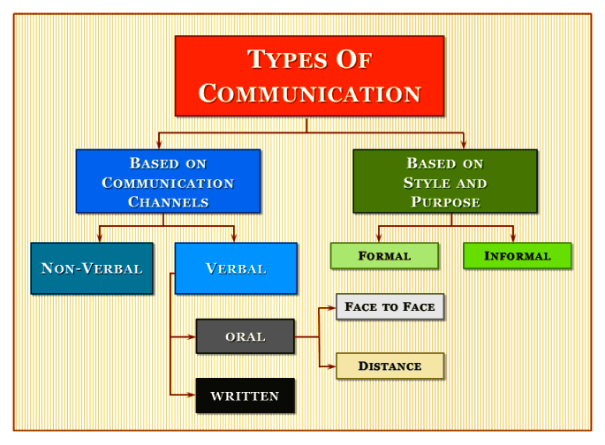
Types of Communication

Slide 10
Features of Technical Communication
Focuses on the receiver, not the sender.
Is efficient and accessible
Is clear and relevant
Follows accuracy
Uses media effectively
Is created by both individuals and teams
Targets a global audience
Is persuasive and truthful
Is based on scientific research and logic.

Slide 11
Thank You
Narendra Singh
CS 2

